Slide 1
MILITARY SPOUSE EMPLOYMENT STUDY
Photos: SSMCP and Defense Department Spouse Employment and Career Opportunities
SSMCP Steering Committee | September 22, 2023

Slide 2
Project Objective
Objective:
Address direct and indirect systemic barriers to workforce participation by military spouses by identifying opportunities for collaboration with:
The military
Federal, state, and local government
Private, nonprofit, educational, and labor partners
Outcomes:
Up-to-date understanding of barriers related to military spouse employment
Strategies to address these barriers and enhance support for military spouses

Slide 3
Recap: Project approach and Schedule
We are here
Apr 2023 | May 2023 | Jun 2023 | Jul 2023 | Aug 2023 | Sep 2023 | Oct 2023 | Nov 2023 | Dec 2023 | Jan 2024 | Feb 2024 | Mar 2024 | Apr 2024 | May 2024 | Jun 2024 | Jul 2024 | Aug 2024
Expert focus groups
Project briefings
Military spouse survey
SC Mtg 1
SC Mtg 2
SC Mtg 3
SC Mtg 4
Stakeholder network mapping
Stakeholder interviews or other info-gathering TBD
Recommendations & report development
Draft recommendations Target: Mar 15, 2024
Final report Target: July 31, 2024
Draft and final report presentations

Slide 4
Major updates since June Meeting
Created a stakeholder network map with nearly 160 contacts and organizations
Formed a Stakeholder Committee and met twice with this group
Developed a survey of military spouses – will launch on October 2!
Developed outreach materials for survey promotion
Conducted preliminary outreach to stakeholders to help promote the survey

Slide 5
Stakeholder Committee
Geography | Organization(s) | Name
Naval Station Everett | NSE Fleet & Family Support Center | Jesse Bennett
 | Economic Alliance of Snohomish County | Rashma Agarwal
Fairchild Air Force Base | Fairchild Air Force Base | Ashley McHan, Marlene Simock
 | Forward Fairchild / Greater Spokane, Inc. | Brian Newberry
Joint Base Lewis McChord | JBLM | Kimberly Smith
 | Thurston County Chamber | Doug Mah
 | Tacoma Pierce County Chamber | Andrea Reay
Naval Base Kitsap | Naval Base Kitsap | Nakia Happli
 | Naval Base Kitsap; Navy Region NW Diversity, Equity, Inclusion, and Accessibility Community | Britt Feldman
 | Olympic College | Tatiane Simons
Naval Air Station Whidbey Island | NASWI Fleet and Family Support Center | Shelby Bassett
NASWI | EDC of Island County | Sharon Sappington
National | Blue Star Families | Laura Torres/ Karly Howell
 | Support the Enlisted Project | Kia Thomas
Statewide | WDVA | Olivia Burley
Notes:
JT

Slide 6
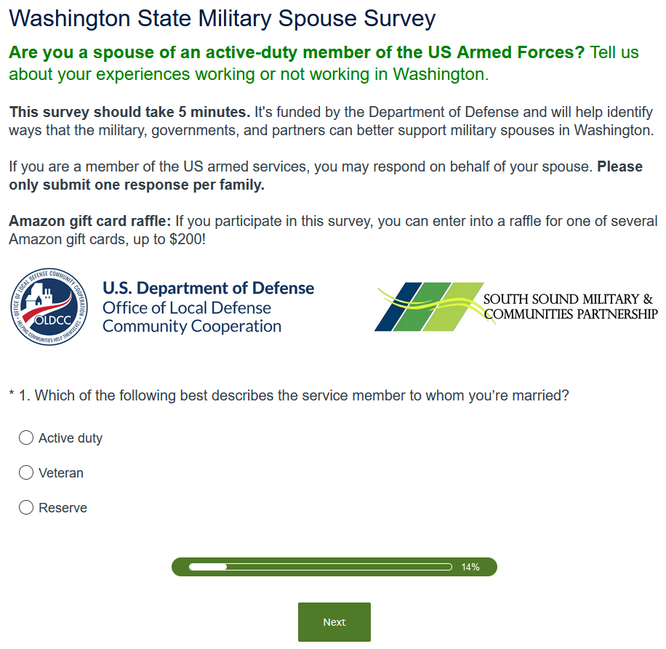
Survey
Objective: Identify existing supports for and barriers to employment by military spouses
Format: 18 – 20 question online survey
A common question: what’s our target response rate?
38,000 spouses in WA
Aiming for a few hundred responses, roughly proportionately geographically distributed
Launches October 2 and open through November

Slide 7
Survey Outreach Channels
POTENTIAL ON-BASE OUTREACH CHANNELS
Child and Youth Services
Commissary
Education centers
Employment readiness offices
ESL classes
Exchange
Family readiness groups
Housing groups
Medical clinics
Military community outreach groups
NW Installations Military Commanders Forum
Public affairs offices
Recreational centers (MWR)
Spouse clubs
Welcome centers
Military installations (see right)
Community groups and orgs that support military spouses and families
Military spouse Facebook groups
If needed: paid geofenced ads on social media (Facebook, Instagram)

Slide 8
Outreach materials
Poster/flyer
Social media graphics
Sample language for social media and email

Slide 9
Focus Groups for Engagement
Groups to Focus On | Methods
Younger people (<40) | Instagram
BIPOC | Affinity groups; on-base and off-base offices and orgs that support military spouses; community groups
People with lower incomes | On-base and off-base offices and orgs that support military spouses; community groups
People who speak English as a second language | ESL classes

Slide 10
Thank you and Next Steps
Please help spread the word about the survey!
We will reach out via email with additional information
Project updates will be shared at www.milspouseemployment.com

