Slide 1


Elected Officials Council
7 NOV 2024 – 0800-1000
Eagles Pride Golf Course
143 registered as of 11.05.24
120 is max capacity
0800 – Breakfast – Networking
0825 – Admin Remarks / Sponsor Recognition
0830 – Welcome from the City of Lakewood, Mayor Jason Whalen
0835 – Remarks from the Nisqually Tribe, Chairman Ken Choke
0840 - Award recognition – Mayor Whalen
0845 – Remarks from Congresswoman Strickland, 10th US Congressional District
0855 – Remarks from I Corps, COL Phil Lamb, Chief of Staff
0905 – Remarks from Madigan Army Hospital Commander, COL Hope Williamson-Younce
0915 – 2025 Legislative Agenda Preview, Shelly Helder
0925 – 2024 SSMCP initiatives update & 2025-2026 Work Plan, Bill Adamson & Maria Tobin
0950 –– Closing Remarks, Pierce County Executive Bruce Dammeier
1000 – Adjourn, networking

Slide 2
Elected Officials Council
KOMO News
Press Coverage

Slide 3
INDIGENOUS PEOPLE AND LANDS ACKNOWLEDGEMENT
Every community owes its existence and vitality to generations from around the world who contributed their hopes, dreams, and energy to making the history that led to this moment. SSMCP would like to recognize that we are on the lands of the Nisqually People, and acknowledge the history of dispossession that allowed for the growth of our community. We offer respect to the Nisqually People and their Elders, past, present, and emerging. We recognize our responsibility to value all people and are committed to equitably serving all people in our diverse community.

Slide 4


Slide 5
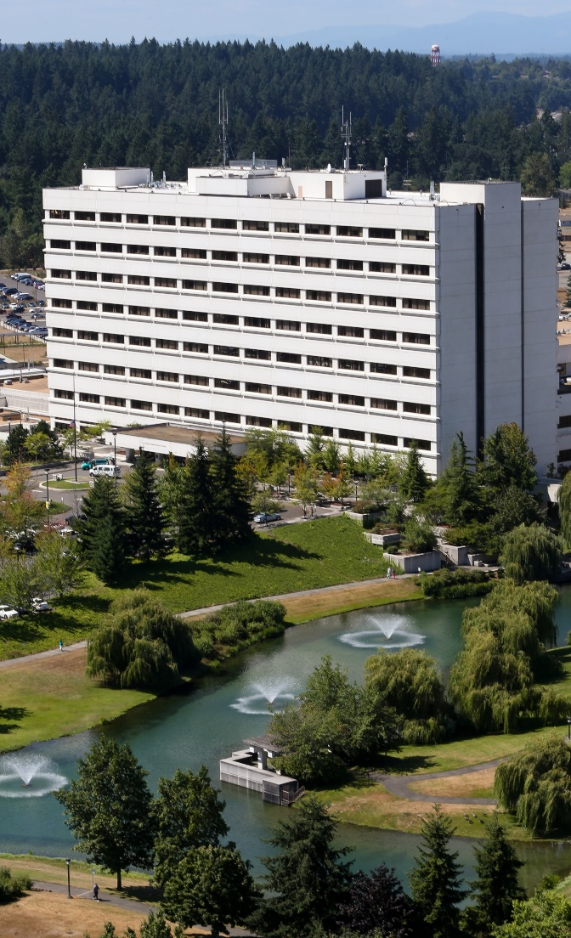


Madigan Army Medical Center’s History
Named after Col. Patrick S. Madigan:
  Medical Corps Officer who served as a Regimental Surgeon with 7th ID in WW1
  Known as the father of Army Neuropsychiatry
Original Hospital opened in 1944 (Fort Lewis General Hospital) - Casualty Receiving Platform
Formally dedicated in August 1945 – Madigan General Hospital
Renamed Madigan Army Medical Center in 1973
Original facility still used today:
  Behavioral Health Clinics & Child and Family Behavioral Health Service
  Andersen Simulation Center and Consolidated Education
  Medical Readiness Battalion, Operations, and Administration
Current facility opened in 1992:
  “State of the Art”
  Multiple upgrades
Notes:
Madigan has a storied history since World War II, caring for more than 7,000 patients from the Pacific Theater.
Today, Madigan still plays a critical role in supporting INDOPACOM as a casualty receiving platform (FCC, NDMS). Madigan also plays a significant role in force generation (power projection) as well as producing the next generation of medical professionals. We are a combat casualty receiving platform.
Madigan and its network of healthcare facilities located in Washington State, California, and the Puget Sound Military Health System, continues to deliver a ready medical force and are focusing efforts on increasing access to care, to support health and medical readiness requirements.

Slide 6

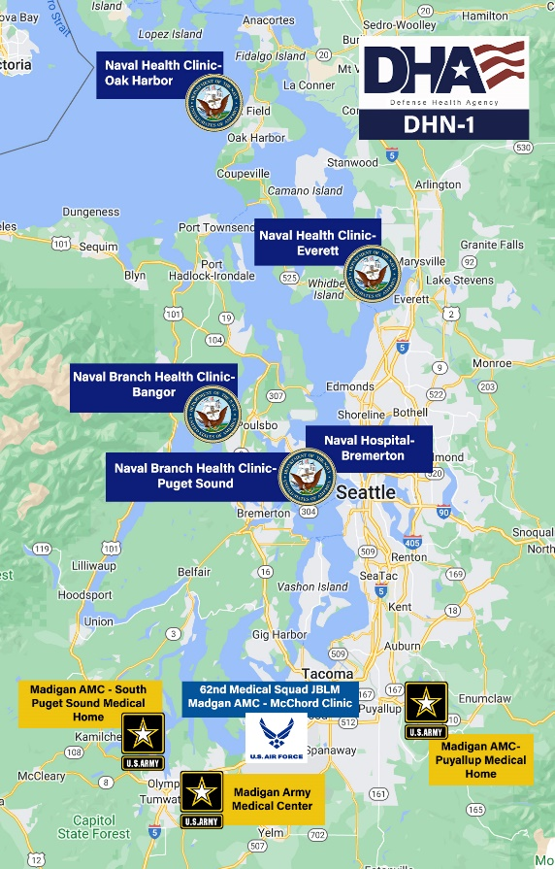


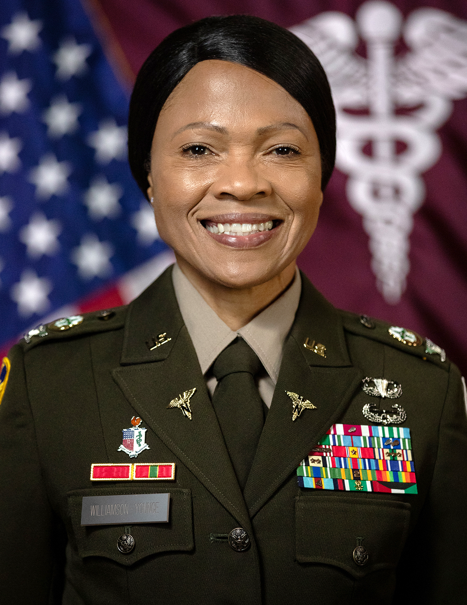
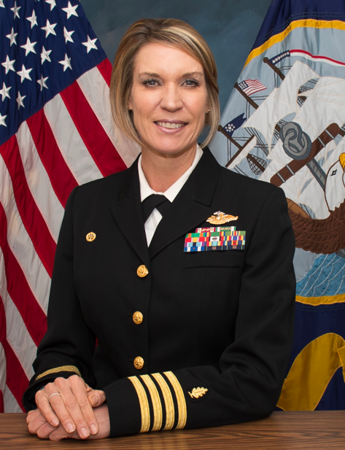
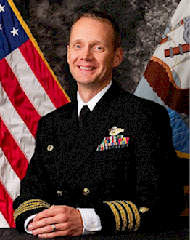
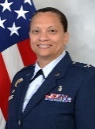
Community Partnerships
Madigan
Army Medical Center
Battalions:
Medical Readiness
Soldier Recovery Unit, California Medical Detachment
Soldier-Centered Medical Home: Allen, Winder, Okubo
Family Medicine Clinic McChord
Community Based Medical Home: Puyallup, South Sound
Naval Hospital Bremerton
Branch Health Clinic Bangor
Branch Health Clinic Everett
Branch Health Clinic Puget Sound Naval Shipyard
Naval Health Clinic
Oak Harbor
62nd Medical Squadron
Defense Health Agency
Our Mission
The Defense Health Agency supports our Nation by improving health and building readiness -- making extraordinary experiences ordinary and exceptional outcomes routine.
Our Vision
Unrelenting pursuit of excellence as we care for our joint force and those we are privileged to serve. Anytime, Anywhere—Always.
6
Notes:
The Puget Sound Consortium includes Madigan, Bremerton Naval Hospital, Oak Harbor Naval Health Clinic, 62nd Medical Squadron and all their assigned clinics around the Puget Sound area, from North Whidbey Island to Lacey.
We are the military’s healthcare system in the Pacific Northwest. Joint focus with Army, Navy, and Air Force medical treatment facilities. Our support extends to the Arctic (Alaska) and INDOPACOM theater.
DHA transition to the Defense Health Networks. Puget Sound realigned to Network 1 (MRC-P) and Network 2 (San Diego).
*Use this slide to talk geographic area our patients are coming from,

Slide 7



Priorities: People, Readiness, Healthcare
VALUES
I CARE
I – Integrity
C – Compassion
A – Accountability
R – Respect
E – Excellence
VISION
Always Ready, Trusted
for Excellence!
#1 Priority People First
Our Staff, Patients, Partners
Recruit/Retain/Succession Planning
Military and Civilian Personnel Management
Leader Development
Leading through Change, Talent Management
Graduate and Professional Medical Education
Medical Force Generation Platform
Readiness
Role 4 Casualty Reception Platform
Individual Critical Task Lists, Wartime
MTOE Assigned Personnel (Operational Forces)
Healthcare Operations Management
Administrative, Financial, Legal, Quality & Safety
MISSION
Team Madigan proudly generates ready, combat credible medical forces; enables a medically ready force; delivers ready reliable care while integrating the medical effort in support of operational forces at JBLM and throughout the United States Indo-Pacific Command Area of Responsibility (USINDOPACOM AOR).
Notes:
Mission: (1) Generates ready, combat credible medical forces, (2) Ensure Warfighters are medically ready to deploy, (3) Delivers Ready Reliable Care, (4) Combat Casualty Care platform.
Our fundamental values are the cornerstone of quality and safety.
We have four focus areas for this year:
Our #1 priority is our people. This encompasses our staff, the patients and families we serve, and the communities we are in. Our strategies will focus on our employee wellness, recruiting and retaining professionals, and managing our personnel.
Leader Development: Leadership is decisive. The way we lead our people through change and transformation is a strength. We will strengthen our programs for change management, talent management (including onboarding and orientation), and our GME/professional medical education programs.
Readiness: We have the sacred mission of readiness on behalf of our Nation. We will continue to strengthen our relationships with the 62nd MED BDE and units we directly support. Our ICTLs and training programs will be strengthened with our focus on rebuilding clinical capabilities at Madigan.
Healthcare Ops: We continue to strengthen our management systems from the DHA transition. Our performance management will center on admin, healthcare delivery, and quality of care (ready reliable care). From a fixed facility to the battle field.
Role 4 Casualty Receiving Platform
Madigan currently has 143 staffed beds out of 253 physical beds and plays a crucial role in the initial reception
of casualties for onward integration into other facilities locally or within CONUS.
Initial estimate to fully expand to Madigan's 535-bed licensed capacity may take up to one year due
to resource allocation, contracting timelines, clinical infrastructure adjustments, and clinical informatics modifications.
Madigan has 14 physical Operating Rooms (ORs) available; currently staffed to run 12 ORs.
Madigan has been integrated in the local trauma system since 1995 as a state designated Level II Trauma
Center; a local trauma partnership network consisting of one Level I Trauma Center in Seattle, two adult Level II Trauma Centers in Tacoma, and one Pediatric Trauma Center in Tacoma.
Partnership with local healthcare systems will mitigate transition time for Madigan's bed expansion in addition
to trauma support.
Madigan operates a high complexity clinical laboratory with the full range of critical clinical services; 24/7 transfusion service; quickly scalable to double the baseline throughput of 4 million tests annually. Madigan has depth and redundancy for all radiology imaging modalities and can readily increase throughput to align with the hospital census.
Previous expansion plans have relied on the use of COMPO 2 or COMPO 3 personnel, however Madigan must revisit this planning to pivot to ready to use / off the shelf contractor support. Additionally, 144 MAMC positions are staffed by MTOE Assigned Personnel (MAP) who will likely be deployed / unavailable.
Way Ahead (Thru FY25):
Updated Facility Survey (Completed AUG 2024) – identifying resource requirements
Refine expansion plan (Ongoing)
Conduct Tabletop, Functional, Full-Scale Exercises to train leaders, validate plan, rehearse critical actions.

Slide 8



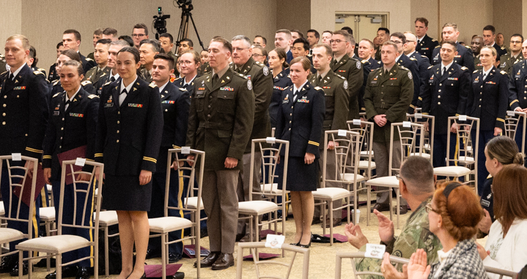
Safe Quality healthcare
Academic & Research Excellence
Graduate Medical Education
29 training programs
17 ACGME programs
320 interns, residents, and fellows
Research
$9 million Research Grants
239 Active Protocols
125 Manuscripts and Presentations
8 Provisional patents
Nursing and Medic Education
Psychiatric Nurse Practitioner
Practical Nurse Course
Certified Nurse Anesthesia Course
Peri-Operative Nursing Course
Operating Room Technician Course
Civilian Education – Healthcare Recruiting
LPN Program
Medical, Nurse & Enlisted Student Population
850 students in training per year
8 Phase II Enlisted Training programs
Medical Skills Rotation
Generating a Ready Medical Force
Generating a Medically Ready Force
Advancing the Delivery of Healthcare on the Battlefield
#1 DoD Graduate Medical Education Program
#1 Obstetrics-Gynecology and Ears, Nose, Throat Program in the Nation
#1 DoD Graduate Medical Education Program & #1 OB-GYN and ENT Program in the Nation
Notes:
The Graduate Medical Education (GME) office oversees the training of interns, residents, and fellows. It also serves as a rotation site for several esteemed medical universities nationwide, including the USU and HPSP programs. In addition, the GME office verifies the postgraduate medical education training at Madigan Army Medical Center, Silas B. Hays Army Community Hospital, and Letterman Army Medical Center.
The Value of Accreditation
The ACGME’s accreditation model and processes ensure and improve the quality of graduate medical education in the United States. This in turn assures the public that today’s residents and fellows are learning and training in a setting that is preparing them to deliver safe, high-quality medical care today and in their future practice.
23 January 2024: Madigan received its annual accreditation letter from the Accreditation Council for Graduate Medical Education (ACGME), receiving the highest level of “continued accreditation without citations or areas for improvement”. ACGME accreditation provides assurance to the public that Madigan, our 17 ACGME programs, and nearly 300 trainees meet the quality standards of the specialty and subspecialty practice(s). Per the ACGME Letter, Madigan GME “demonstrates substantial compliance with requirements.”

Slide 9
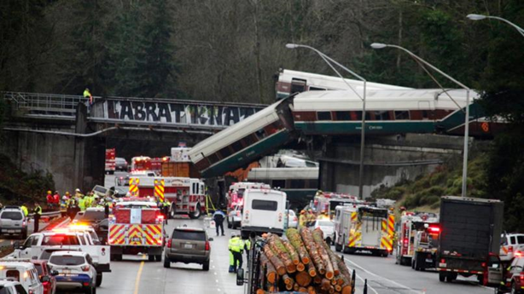

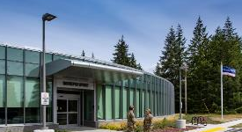

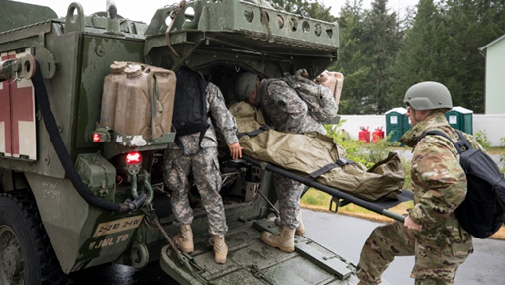
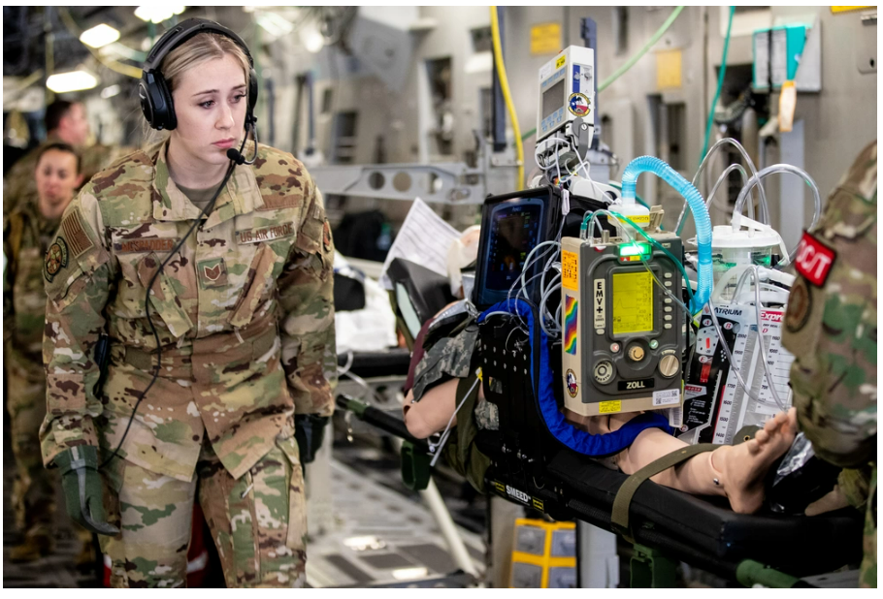
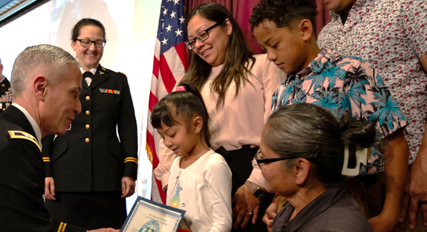
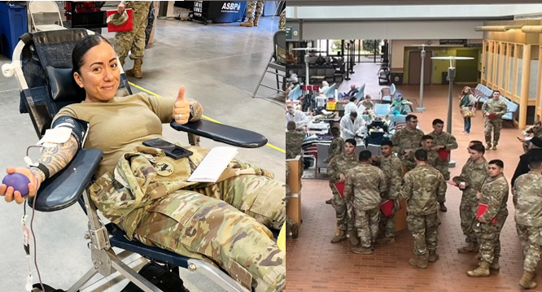
Community Engagement – theater support
Whole of Community Support Amtrak Train Derailment
JBLM Center for Autism, Resources Education & Services (CARES)
Traumatic Brain Injury and Intrepid Spirit Center
Anderson Simulation Center
2024 Graduate Medical Education Capstone
2023 Ultimate Caduceus Exercise (Indo-Pacific)
Celebrating our Young Heroes
Supporting our Community: Walking Blood Bank
Notes:
Our Mission: Ready Medical Force and Medically Ready Force
Theater Support (INDOPACOM): Example of Ultimate Caduceus 2023. TRANSCOM led exercise with casualties flowing from Guam to Alaska and then Madigan.
Whole of Community Support (South Puget Sound): Amtrak derailment in December, 2017. 70 people were injured and Madigan took 19 patients in the MASCAL. Madigan staff were part of the first responders as they were driving to work.
Troop Support with the Gift of Life: Madigan staff supported capabilities for COVID Augmentation and Immunizations. COVID Testing tent was setup outside the Emergency Department and at McChord Air Field.
Madigan has to provide military professional staff for deployment and hospital support (252 bed capability).
Our Mission: Ready Medical Force and Medically Ready Force
Trauma Trust: Trauma Support (South Puget Sound): Amtrak derailment in December, 2017. 70 people were injured and Madigan took 19 patients in the MASCAL. Madigan staff were part of the first responders as they were driving to work; good Samaritans.
CARES – MSG Place
School Based Health System clinics in 10 area schools, military teenagers with TRICARE Prime insurance can get care in their school clinics one day a week. Students can be seen for acute, minor and chronic illnesses, sports physicals, immunizations and to manage long-term medications such as those for asthma and allergies. In addition, students can access counseling for behavioral health concerns, as well as laboratory and basic pharmacy services.
4. Theater Support (INDOPACOM): Example of Ultimate Caduceus 2023. TRANSCOM led exercise with casualties flowing from Guam to Alaska and then Madigan.
Madigan has to provide military professional staff for deployment and hospital support (252 bed capability).
Cost of Unfunded Programs:
TBI (Congressional Mandate) - $2.2M
Pain Management - $3.5M
SRP - $3.5M
CARES - $755K
Outpatient Infusion Services - ~ $500K
XLRP - ~$500K
Faith Clinic (Adults with disabilities) - ~ $500K

Slide 10
Care With Compassion!
MAJ Michelle Liebel-Salopek, michelle.a.liebel-salopek.mil@health.mil, 253-968-1195

Slide 11
Elected Officials Council
Shelly Helder
Gordon Thomas Honeywell
Governmental Affairs
Senior Consultant

Slide 12
SSMCP 2025 Legislative Agenda
“State leadership has a prime opportunity to extend its longstanding record of defense support to attract additional missions, enhance service member quality of life, and promote the defense economy, thereby contributing significantly to our national defense while reaping the economic benefits for the residents of Washington.” (Pg 103 of report)

Slide 13
DRAFT 2025 SSMCP Legislative Agenda
Defense Industry’s Economic Impact on Washington
Military Family Quality of Life
Defense Community Compatibility Account (DCCA)
I-5 Mounts Road to Tumwater & Nisqually River Delta
SSMCP Policy Positions
Strengthen State Support for Military Affairs in Washington
Expand the Workforce
Improve Infrastructure Resiliency

Slide 14
SSMCP 2025 Legislative Agenda
Defense Industry’s Economic Impact on Washington
For the first time in over a decade the defense industry’s economic impact on Washington State has been quantified. A legislatively directed report, completed September 2024, concluded roughly 4% of gross state product (GSP), or $30.9 billion, was connected to the defense economy. The military and defense sector’s contribution to Washington’s GSP is greater than that of agriculture, clean technology, forest products, life sciences and global health, maritime, and tourism. Further, defense expenditures supported 254,904 jobs in FY23, representing over 5% of total statewide employment.
“Different states have different approaches to conducting their military affairs, but the states with some of the most defense activity have a common trait: a centralized organization composed of military and defense subject matter experts that reports to the Governor and communicates directly with installation leadership.” (WA EIA 2024, Pg. 97)
“State leadership has a prime opportunity to extend its longstanding record of defense support to attract additional missions, enhance service member quality of life, and promote the defense economy, thereby contributing significantly to our national defense while reaping the economic benefits for the residents of Washington.” (WA EIA, Pg. 103)

Slide 15
SSMCP 2025 Legislative Agenda
Military Family Quality of Life
Some of the greatest challenges facing military families in the South Sound are access to housing, childcare and employment for spouses. SSMCP is working regionally to remove barriers to these necessities and supports state level action through 1) incentives, 2) increased investment, 3) reduction in administrative burdens that drive up costs, and 4) coordination with other military installations and communities.
“Key to encouraging DoD investment and enhancing service member quality of life is having a robust military engagement organization at the state level that can advocate for transition, education, and employment assistance as well as full benefits and healthcare.” (WA EIA 2024, Pg. 97)

Slide 16
SSMCP 2025 Legislative Agenda
Defense Community Compatibility Account (DCCA)
SSMCP requests the biennial capital budget fully fund the DCCA project list, as recommended by the Department of Commerce. This grant program supports civilian communities near military installations and leverages federal investment in our state. For SSMCP, this would mean $1M to purchase a property in the McChord Airfield North Clear Zone. This long-term plan of resolving encroachment has a commitment of up to $80 million from the federal government but requires a 20 % state match.
I-5 Mounts Road to Tumwater & Nisqually River Delta
SSMCP continues to partner with the Nisqually Indian Tribe and other regional agencies to support the critical work along I-5 to improve infrastructure resilience against erosion and flood risk, restore critical habitat and improve mobility. State funding has allowed the project to advance to the NEPA stage and a preferred alternative will be identified then designed. Additional state or federal funds are required to finalize engineering work. This includes $1.5 million for preliminary engineering of part time shoulder use on southbound I-5 between Sleater-Kinney and Henderson Boulevard. This practical solutions approach would improve the transportation outcomes of the initial investment the state has made in the Nisqually River delta.

Slide 17
Bill Adamson & Maria Tobin
SSMCP Initiatives
I-5 Funding & Options - FYI
2025-26 SSMCP Work Plan - implementation
Community / Business Survey results - FYI
Military / Defense Economic Impact - messaging
Military Installation Resiliency Review – next steps
Military Spouse Employment Study – results, next steps

Slide 18
I-5 Nisqually Delta Funding Timeline - 09.2024
I-5 review
Planning & Environmental Linkages Study
Preliminary engineering and ROW acquisition. Includes $21M for 3 roundabouts on SR 507
Preliminary
final CEVP
(cost estimate validation process)
USGS Hydrology Study*
Corridor Study
NEPA/
SEPA
$500K
$2.25M
$300K
$5M
$75M
$3.8B - $6.0B
2028
2018
2019
2020
2021
2022
2023
2024
2025
2026
2027
*funded by Nisqually Indian Tribe
Next steps
Complete NEPA
Summer 2025
ID preferred alternative
2026
Design & Engineering
2026-27
Right of Way Acquisition
2027-28
Construction
2029
Notes:
anticipated to be in the final CEVP (cost estimate validation process) report due next month.

Slide 19
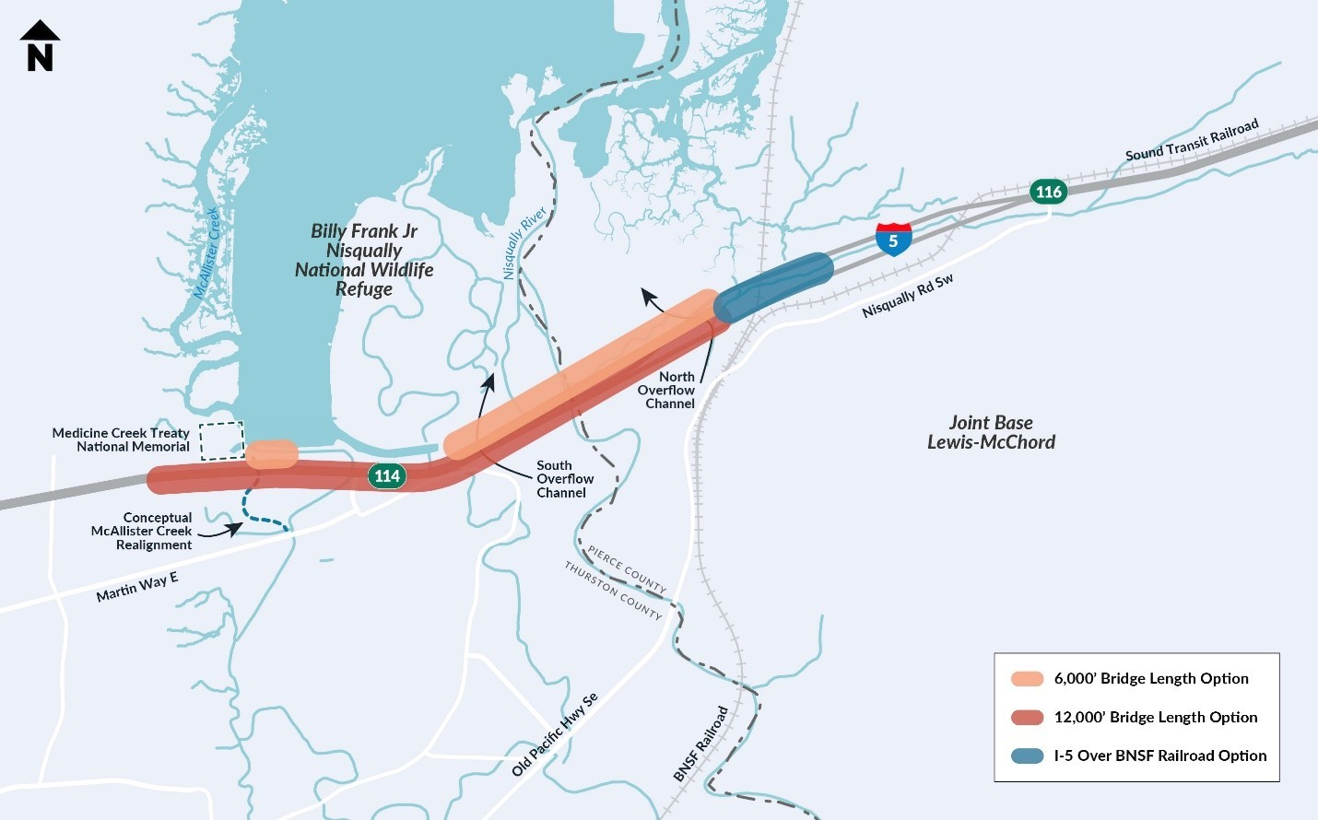
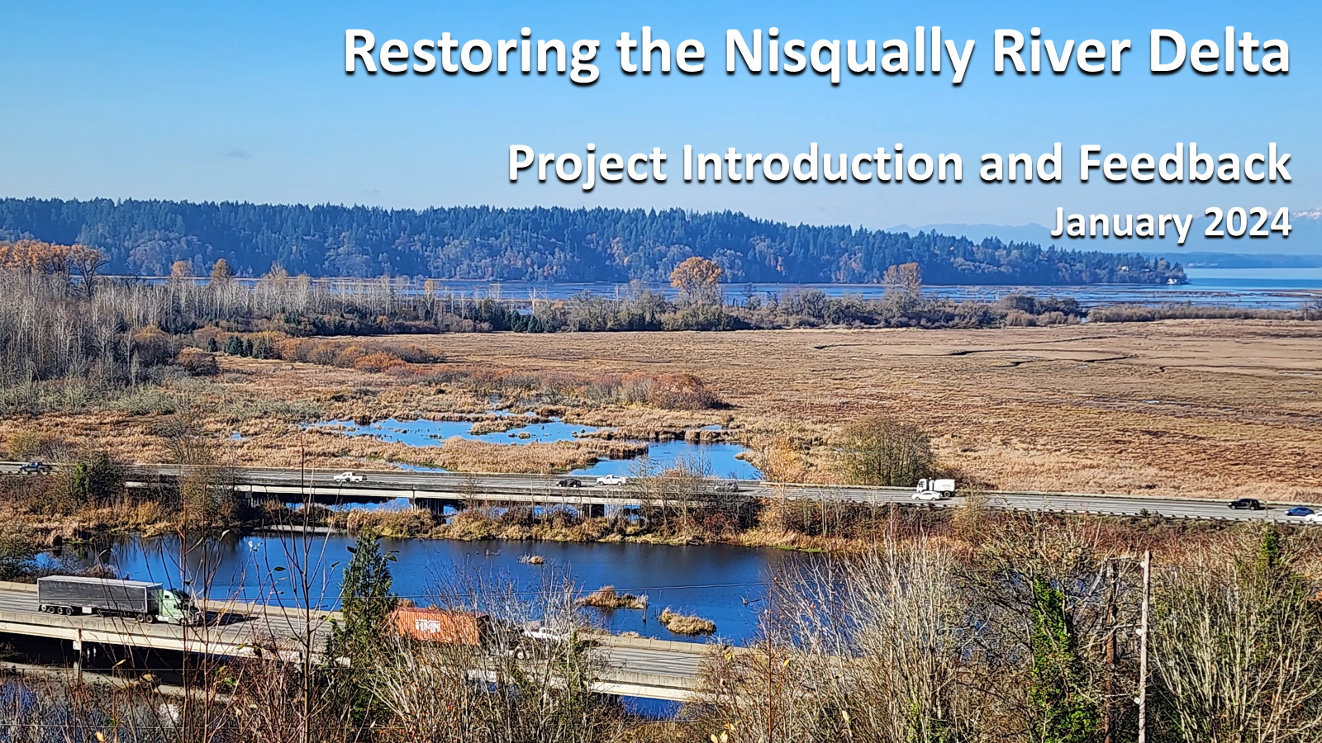
I-5 nisqually delta options Update

Slide 20
2025-26 SSMCP Work Plan
Manage federal grant to implement Military Installation Resiliency Review (MIRR) recommendations:
Implement Defense Community Transportation Corridor Study (Transportation Work Group) (SSMCP)
Engage / assist in developing a Defense Community Communications Interoperability Plan (JBLM)
Promote Energy Grid Resilience Project (JBLM)
2. Implement relevant recommendations from statewide military/defense sector economic impact analysis
Establish statewide unified approach for defense community coordination
Leverage economic impact study to conduct information, education, and awareness campaign (Bus & Econ Dev WG)
Promote and enhance the use of the Defense Community Compatibility Account such as clear zone encroachment
Advocate / promote military spouse initiatives (Legislative Agenda)
Pursue funding for I-5 improvements (Legislative Agenda / Transportation WG)
Assist in expanding childcare through better comprehensive community planning and growing local and state partnerships (Education WG)
Conduct JBLM Joint Land Use Study in 2026 (Reconstitute JLUS Task Force)
Inform / educate state legislators about SSMCP and advocacy in state-level activities (Legislative Agenda)
Monitor / engage when appropriate the Commercial Aviation Work Group (SSMCP staff)

Slide 21
SSMCP Community Business Survey - REsults
This survey seeks to identify the military connected customer bases of local
businesses and the perceived effects of JBLM on the local economy.
  2019 2024
Responses: 560 581
Business operator/owner = 56% 30%
Perceived economic impact of JBLM on the region:
  < $1.0 Billion: 10.0% 0.5%
  $1 - $5 Billion: 45.0% 13.4%
  $6 - $10 Billion: 30.0% 13.9%
  $10+ Billion: 15.0% 8.56%
  I don’t know: n/a 63.4%
Rate your opinion of JBLM's impact on the local economy – 4.2 stars

Slide 22
SSMCP Community Business Survey - results
JBLM helps attract talent to the region– 75%, (2019) 70% (2024) of respondents did not live in Pierce/Thurston county prior to their military affiliation. When they come, they tend to stay – 63% (2019), 76% (2024) self-report as homeowners.
Respondents Status: (2024)
AD / spouse 2.5%
DOD employee 3.0%
Vet, Retiree, NG, Res 49.5%
Non-military 45%
Years affiliated with JBLM: (2019) (2024)
0-1 year 4.0% 9.9%
2-5 years 17% 12%
6-10 years 9.0% 12.6%
> 10 years 71.0% 66%
Generating local business: (2019) (2024)
Car 66% 71.6%
House 63% 76.5%
RV 10% 12.5%
Boat 5% 14%
Investment property 5% 13%

Slide 23
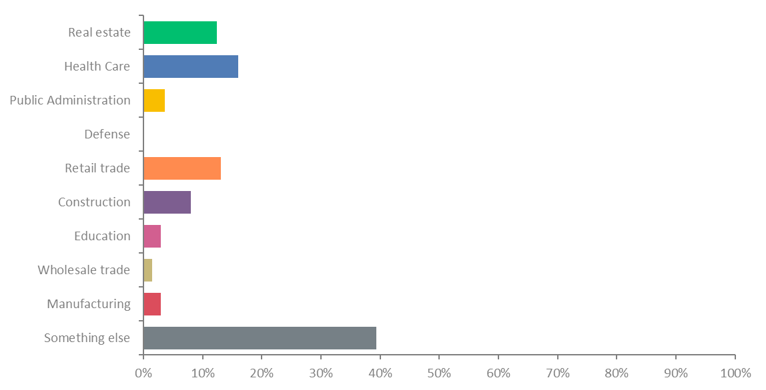
Business Operator Response
137 businesses responded
66% have no military affiliation
30% veterans
Business characteristics:
  <5 employees 55%
  6-20 employees 25%
  21-50 employees 10%
  51-100 employees 3.0%
  >100 employees 7.0%

Slide 24
Business Operator Response
What percentage of your business revenue can be attributed to the presence of JBLM?
137 responses
62.77%
26.3%
7.3%
3.7%

Slide 25





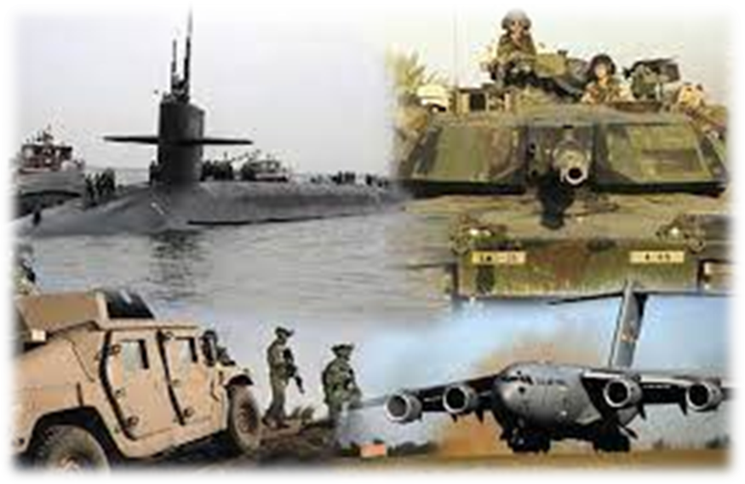
Statewide Military / Defense sector economic impact
JBLM
78,890 jobs
Whidbey Island NAS
14,297 jobs
Fairchild AFB
7,776 jobs
NAS Everett
6,748 jobs
Naval Base Kitsap
61,104 jobs
The state-wide military defense sector economic impact analysis has demonstrated the importance of the military to the State’s economy
Economic Impact
$30.9B
Statewide Jobs
254,904
4%, of gross state products
5% statewide employment
Notes:
Washington is vital to our nation’s defense and power projection capabilities. For the first time in over a decade we know the economic impact of the defense industry on Washington state’s economy - and it’s big. WA is the home of six military installations, over 100,000 personnel, over 185,000 military family members, over 525,000 veterans and retirees, and numerous private contractors. The state has 713,000 military affiliated residents.
Nearly $31B or 4% of GSP is connected to the defense economy. About a quarter of a million jobs can be attribute to the defense sector.

Slide 26

Defining the Defense Economy
Spending flows
  Personnel compensation
  Procurement
  Veteran and retiree pensions and transfers
Economic Impact Analysis
  Estimates how defense spending ripples through the state economy
  Captures direct, indirect (business to business), and induced (consumer spending) impacts
  Utilizes the industry-standard IMPLAN economic model
Category | Personnel 2023
Active Duty | 57,838
Reserve | 9,172
National Guard | 7,716
DoD Civilian | 32,040
Veterans | 533,346
Retirees | 72,916
26
Notes:
The consultant team from Matrix Design Group conducted a statewide analysis of the entire military and defense sector and separate analyses for each of Washington’s major installations:
Defense spending directly supported thousands of jobs, not only in the military, but also in the industries that provide goods and services to the DoD and the service member community.
As this spending rippled through the economy, it stimulated business-to-business transactions in the supply chain and household spending of labor income, respectively referred to as indirect and induced effects.

Slide 27
Defense-Related Spending Summary
Direct Defense Spending
Spending Flow | Amount (FY23)
Personnel Compensation | $11.2 billion
Procurement | $7.3 billion
Veteran and Retiree Pensions and Transfers | $8.6 billion
Total | $27.1 billion
Pensions & Transfers 32%
Personnel Compensation 41%
Procurement 27%
Sources: Bureau of Economic Analysis, usaspending.gov, National Center for Veterans Analysis and Statistics
Impacts in current (2024) dollars; include direct, indirect, and induced effects
27
Notes:
In addition, there is $1.8 billion in state and local tax revenue not accounted for on this slide.

Slide 28
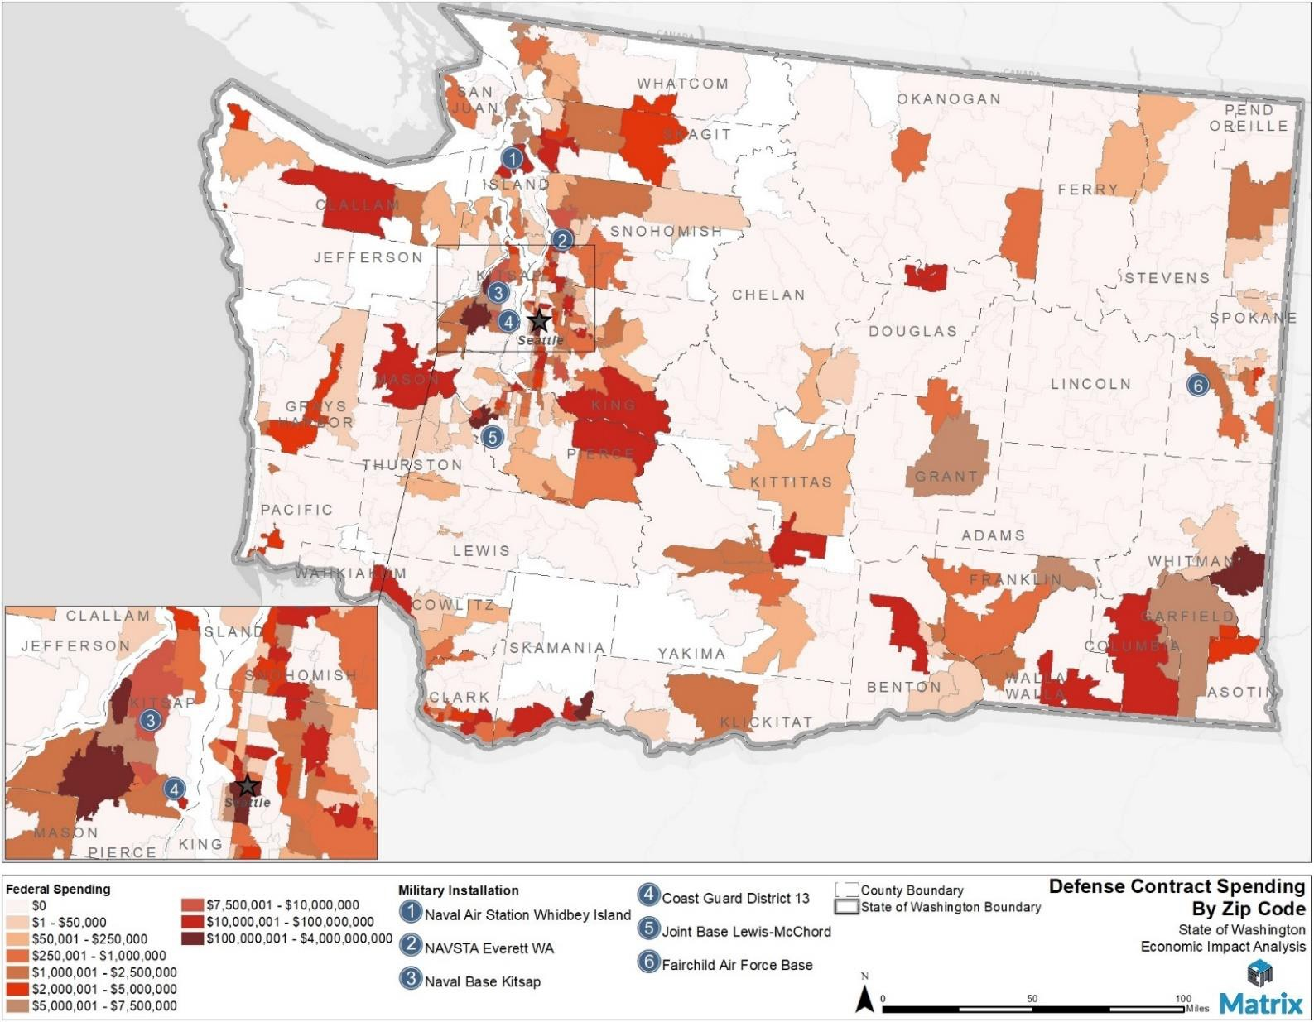
Defense Contract Spending Across Washington
Top 10 Counties by Procurement Spending:
Douglas ($54 M)
Island ($137 M)
King ($4.5 B)
Kitsap ($1.1 B)
Klickitat ($134 M)
Pierce ($633 M)
Skagit ($55 M)
Snohomish ($318 M)
Spokane ($75 M)
Whitman ($119 M)

Slide 29
Economic impact analysis Outcomes
Washington is #11 in total defense spending and #7 in number of personnel in the nation
Economic Impact = $30.9B
Jobs = 254,904
Industry Sector Comparison
SWOT Findings
Aerospace
Creative Economy
Information & Communication Technology
Military / Defense
Agriculture
Clean Technology
Forest Products
Life Sciences & Global Health
Maritime
Tourism
Need for improved, consistent statewide and local coordination
Undersubscribed sector which creates massive economic opportunities for the state.
SWOT analysis IDs military quality of life challenges (affordable housing, childcare, and military spouse employment barriers).
Need for an appropriate staff structure
Notes:
MIL/Defense Sector ranks fourth among the state’s industry sectors as shown on this slide. The second aspect of the economic impact report is a SWOT analysis based on interviews with the installation command groups. Affordable housing, childcare and military spouse employment barriers were common weaknesses among our installations.
To address these challenges and others identified in the survey, Washington needs a unified approach to defense community coordination. Currently no organization or office is charged with this critical responsibility.
An OpEd published in newspapers across the state written by MG® Jimmy Collins and Dave Zeeck (former publisher of the TNT) describes very well the need for such a state office.

Slide 30
How do Other States Organize?
Statewide Unified Approach for Defense Community Coordination
All have offices are separate from the Veterans Department, state military department and national guard.
streamline business development, supporting military families, and protecting military installations.
encourage defense-related businesses to expand or relocate in the state
maintain and grow military operations in the state, providing insight and recommendations to state leaders
support the efforts of local and regional organizations to improve partnerships with military installations
coordinate state and local efforts to enhance the quality of life of military personnel
advocate for service members and their families
Notes:
Different states have different approaches to conducting their military affairs, but the states with some of the most defense activity have a common trait: a centralized organization composed of military and defense subject matter experts that reports to the Governor and communicates directly with installation leadership. The Washington Legislature should look to other states for examples of how to do this successfully. Importantly, states that have done this well have offices separate from the Veterans Department, state military department and national guard. This analysis researched: Texas, California, Virginia, Florida, and Connecticut.
Military Enhancement Committees (MECs) have become increasingly valuable over the last five years as the Department of Defense has begun assessing community support for installations when deciding where to commit funds and assign military missions. Washington can best help local MECs by providing start-up assistance, whether that be in the form of initial funding or organizational support.

Slide 31
Military Installation Resiliency Review
The overarching goal was to increase the military value of the installation by preserving the military mission and promoting continued community growth, resilience, and economic development through community investments outside the fence line.

Slide 32

Risk Assessment Results/Assets
Lifeline | Asset Name | Total Risk Score
Transportation | Interstate 5 | 419
Transportation | SR - 016 | 330
Transportation | SR - 512 | 323
Transportation | Nisqually Road / Old Pacific Highway | 300
Transportation | US - 101 | 282
Transportation | SR-507 | 267
Transportation | Burlington Northern Santa Fe Rail Line -- Running through Base | 247
Health and Medical | MultiCare Good Samaritan Hospital​ | 240
Transportation | SR-510 | 240
Transportation | SR-7 | 228
Energy | Alder Dam | 216
Water Systems | North Fork Clover Creek W1 Det Facility | 216
Energy | Olympic Petroleum Pipeline | 188
Energy | US Oil Refinery 8" Jet fuel Pipeline | 188
Natural Resources | Wildlife Refuge - Billy Frank Jr. Nisqually National Wildlife Refuge | 173
Safety and Security | Pierce County Sheriff Department - Parkland Substation | 171
Transportation | Pierce County Central Maintenance Facility (CMF) | 171
Water Systems | North Fork Clover Creek E1 Det Basin | 171
Health and Medical | Providence St. Peter Hospital​ | 165
Transportation | Seattle-Tacoma International Airport | 165
The purpose of the risk assessment is to identify those assets most at risk to hazards and use this as a prioritization metric to position projects for adaptation planning to increase their resilience to future events.

Slide 33
priority Resiliency Action Plans for funding
 | PROJECT NAME | PROJECT DESCRIPTION
1 | Defense Community Transportation Corridor Study | ID corridors critical to installation access, conduct a risk assessment of each, and establish adaption recommendations for each corridor
2 | Defense Community Communication Interoperability Plan | Improve interoperability of communications between JBLM and key regional partners
3 | Defense Community Energy Grid Resilience | ID and prioritize power generation, transmission, and storage technologies that benefit the community and JBLM.
Total of 9 Resilience Action Plans recommended from the MIRR study: Transportation, Communication, Energy Grid Resiliency, Basic SVC member needs, Emergency Water, Health Commo/Data sharing, Medical surge

Slide 34
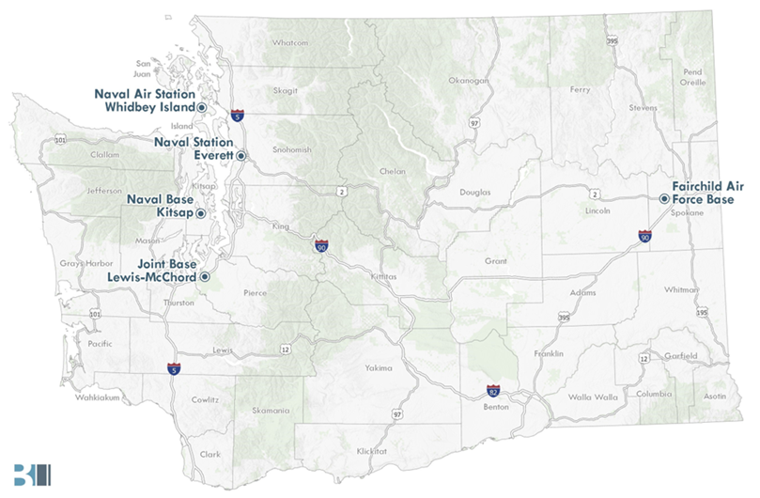

Project Objectives
Military Spouse Employment Study
Understand direct and indirect systemic barriers to workforce participation by military spouses
Identify strategies to address these barriers through collaboration between:
  The military
  Federal, state, and local government
  Private, nonprofit, educational, and labor partners
Notes:
[Speak to bullets on slide]

Slide 35
Draft Recommendations: Overview
19 Recommendations
84 Strategies
64 Local & State-directed Strategies
Focus Areas
Childcare
Employment resources
Employer bias
Outreach
Financial support
Data, research, and advocacy
Note: Scope focuses on solutions specific to military spouses
Key Players
Military | DOD
 | Service branches
 | Installations
Government | Federal
 | State
 | Local
Private and nonprofit sector | Employers
 | Community organizations
 | Off-base childcare
Notes:
Six focus areas for our recommendations, which we’ll cover on the next few slides. Those focus areas are [read slide]
The Recommendations are fairly high-level – so in the final report, each recommendation will be accompanied nested Strategies that identify more specific supporting actions. We won’t be sharing our draft Strategies today, as they’re still in flux and they’re more detailed than we have time for in this presentation. I will note that all our Strategies are focused on solutions that are specific to military spouses. What I mean: we know that military spouses face many of the same challenges that confront many Americans – issues with housing affordability, childcare, access to resources. There’s some big, systemic things that could be done on a national level to address these issues, but in the interest of keeping our report focused and attainable, we’ve limited our scope to Strategies that specifically, directly support military spouses.
For each of our Strategies, we also identify one or more key players that we think could play a role in implementation. We’ve identified nine key players, organized into three categories: [read slide]

Slide 36

Study Recommendations
Key findings
#1 Barrier to military spouse employment is childcare, with more than 2/3 of respondents saying that the lack of access to childcare is preventing them from working.
That number goes up to over 90% of respondents with children under the age of six.
More than 40% of respondents said other employment barriers included:
Finding suitable/lateral employment
Financial challenges
Relocation
Military spouse employment needs more outreach
More than 1/3 of military spouses surveyed said that they would like to receive more information.
Statewide Mil Spouse Focus Groups revealed significant gaps in spouses’ awareness of resources available
Most employed respondents said that their employment was essential to meet their family’s basic needs
Notes:
Childcare is our first focus area
Five recommendations
The first four focus on expanding military families’ access to childcare, including on-base and off-base childcare. Strategies centered around issues like waitlists, provider caps, or family income caps.
The fifth focuses on access to other financial supports for childcare, like state and federal subsidies or the new Dependent Care Flexible Spending Account available to service members

Slide 37

Study Recommendations
(Child Care)
LOCAL RECOMMENDATION: Improve access to off-base childcare
STRATEGY:
Reduce bureaucratic barriers to establishing a childcare business for home-based and childcare centers.
STRATEGY:
Raise awareness of federal and state childcare subsidy programs among military
spouses to supplement military subsidies and support military families in applying.
STATE RECOMMENDATION: Build awareness of other financial supports for childcare
Notes:
Childcare is our first focus area
Five recommendations
The first four focus on expanding military families’ access to childcare, including on-base and off-base childcare. Strategies centered around issues like waitlists, provider caps, or family income caps.
The fifth focuses on access to other financial supports for childcare, like state and federal subsidies or the new Dependent Care Flexible Spending Account available to service members

Slide 38
Mil Spouse …Study Recommendations
(employment resources)
STATE RECOMMENDATION: Continue focus on occupational licensure portability
STRATEGIES:
Continue efforts to pursue more interstate licensure compacts. (Thank you!!)
Implement and build awareness about new licensure and certification reciprocity for military spouses.
Develop a policy to enable foreign military spouses to translate their foreign certifications into Washington opportunities.
Cover the costs for spouses’ licensure or certification.
LOCAL RECOMMENDATION: Enhance direct employment support for military spouses.
STRATEGIES:
Strengthen coaching and resources to support military spouses.
Emphasize military spouses in employment support provided to the broader military community.
Notes:
Childcare is our first focus area
Five recommendations
The first four focus on expanding military families’ access to childcare, including on-base and off-base childcare. Strategies centered around issues like waitlists, provider caps, or family income caps.
The fifth focuses on access to other financial supports for childcare, like state and federal subsidies or the new Dependent Care Flexible Spending Account available to service members

Slide 39
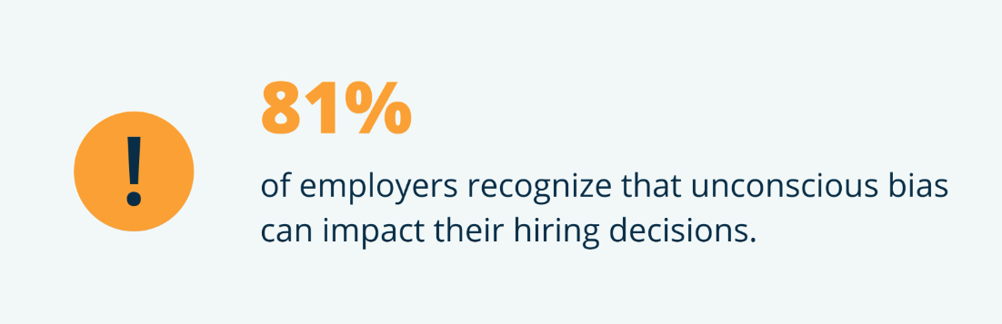
Study Recommendations
(employer bias)
STATE & LOCAL RECOMMENDATIONS: Protect military spouses from employer bias.
STRATEGIES:
Build awareness of existing protections for military spouses at the state and federal levels.
Introduce antidiscrimination protections for military spouses at the state and federal levels.
Notes:
Childcare is our first focus area
Five recommendations
The first four focus on expanding military families’ access to childcare, including on-base and off-base childcare. Strategies centered around issues like waitlists, provider caps, or family income caps.
The fifth focuses on access to other financial supports for childcare, like state and federal subsidies or the new Dependent Care Flexible Spending Account available to service members

Slide 40
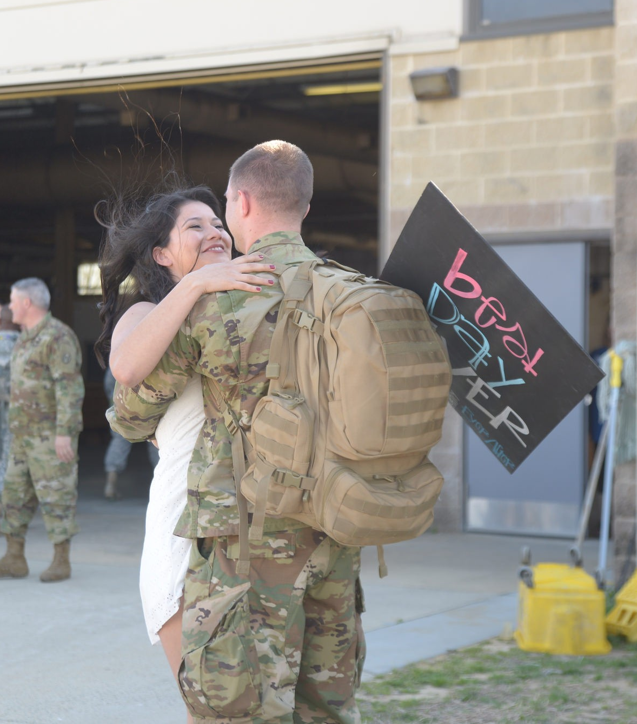
Study Recommendations
(outreach)
LOCAL RECOMMENDATION: Improve outreach about resources to military spouses.
STRATEGIES:
Maintain up-to-date official government webpages about resources for military spouses.
Strategize on new marketing efforts on resources for military spouses.
LOCAL & STATE RECOMMENDATION: Encourage employers to hire military spouses.
STRATEGIES:
Conduct a campaign to educate employers on military spouses’ employment strengths and improve employers’ cultural competency regarding military spouses.
Offer state tax incentives to employers to hire military spouses- HB 1005 (2023).
STATE RECOMMENDATION: Facilitate employers’ abilities to hire and retain military spouses.
STRATEGIES:
Encourage out-of-state employers to hire WA military spouses through simplified administrative policies.
Expand tools and guidance for employers to improve their readiness to employ military spouses.
Notes:
Childcare is our first focus area
Five recommendations
The first four focus on expanding military families’ access to childcare, including on-base and off-base childcare. Strategies centered around issues like waitlists, provider caps, or family income caps.
The fifth focuses on access to other financial supports for childcare, like state and federal subsidies or the new Dependent Care Flexible Spending Account available to service members

Slide 41

Study Recommendations
(Financial Support)
LOCAL, STATE & FEDERAL RECOMMENDATION: Expand military families’ access to financial support and basic needs assistance available outside the military community.
STRATEGIES:
Build awareness among military families about financial assistance programs such as the Supplemental Nutrition Assistance Program (SNAP) and supplement for Women, Infants, and Children (WIC), and when Basic Allowance for Housing (BAH) is or is not included in income eligibility calculations.
Exclude BAH in calculating family income for SNAP eligibility.
Notes:
Childcare is our first focus area
Five recommendations
The first four focus on expanding military families’ access to childcare, including on-base and off-base childcare. Strategies centered around issues like waitlists, provider caps, or family income caps.
The fifth focuses on access to other financial supports for childcare, like state and federal subsidies or the new Dependent Care Flexible Spending Account available to service members

Slide 42
Study Recommendations
(Data, research, and advocacy)
LOCAL AND STATE RECOMMENDATION: Conduct research to ensure efforts are data-informed and relevant.
STRATEGIES:
Regularly engage military spouses to gather feedback on current efforts and gaps.
Evaluate program efficacy to identify opportunities for improvements or reinvestment of funds.
Invest in pilot projects to test strategies to support military spouses better.
Begin conversations to evaluate whether and how to extend support to service members’ unmarried partners.
LOCAL AND STATE RECOMMENDATION: Cultivate a strong, cross-sector network of groups that support military spouse employment.
STRATEGIES:
STRATEGIES:
Continue and expand collaboration and resource-sharing regionally and statewide.
Enhance communication across groups to build on existing work .
Notes:
Childcare is our first focus area
Five recommendations
The first four focus on expanding military families’ access to childcare, including on-base and off-base childcare. Strategies centered around issues like waitlists, provider caps, or family income caps.
The fifth focuses on access to other financial supports for childcare, like state and federal subsidies or the new Dependent Care Flexible Spending Account available to service members

Slide 43


Mil spouse employment next steps
When: 21 November 2024
Time: Half-day event from 9AM-Noon
Where: Eagles Pride Grill
Cost: Free event
Learn more about this event here:

Slide 44


Military Family Quality of Life Symposium Series
Military Spouse Employment Symposium – November 21, 2024
Behavioral Health Care Forum-January 2025
Military Child Education Symposium-April 2025
Childcare Symposium-TBD 2025

Slide 45


Thank you for attending Today’s Elected Officials Council
Save the Date for our next EOC!
May 15, 2025
Notes:
Fortunately, Lakewood is not alone in recognizing that it had work to do to reduce these unnecessary and unintentional barrier to childcare. Here is what other jurisdictions are doing at the local, regional, and state levels to reduce barriers to childcare.
*In 2020, Seattle past the Childcare Near You Ordinance which zoned centers and home based childcare outright for residential and nearly all zones in the City.
At the state level, the state made allowances for local jurisdictions to waive traffic impact fees and it made it illegal for landlords and HOA to unnecessarily restrict home based childcare business.
The final point to be made here is that we have many other jurisdictions recognizing the need to reduce these unnecessary barriers limiting expansion of childcare

